Slide 1
Level 2 Final Project
Michael Everett

Slide 2
Rate background
People submit ballots via .txt file
The .txt files are run through some code to determine the overall scores
Issues
Files can be over 100 lines long, filled out manually
Easy to make mistakes and the code is quite fragile
Create a way to automate the creation of the ballot .txt file?

Slide 3
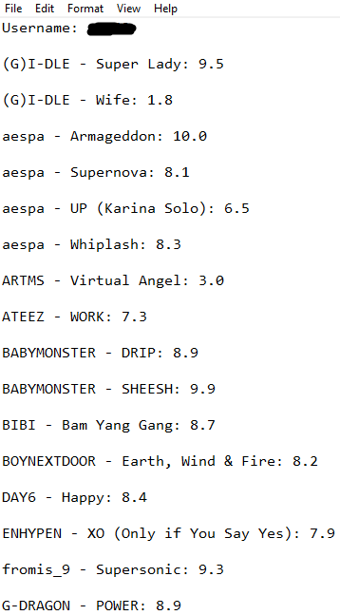
How the .txt file should look
Key points:
Maximum of 1 decimal place
1-10 scoring
Artist – Song: X.X (the space after the : is important)

Slide 4
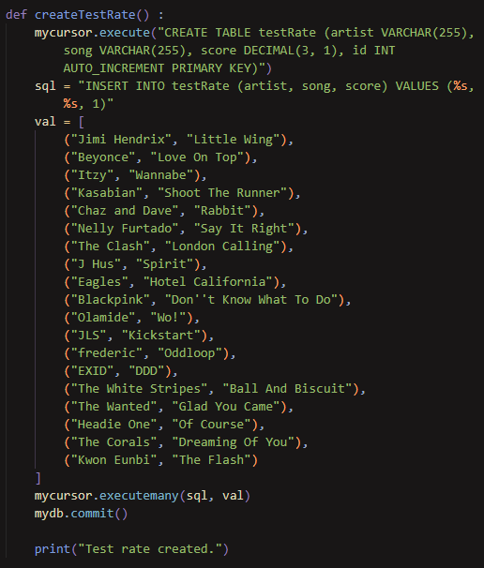
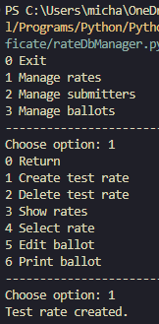
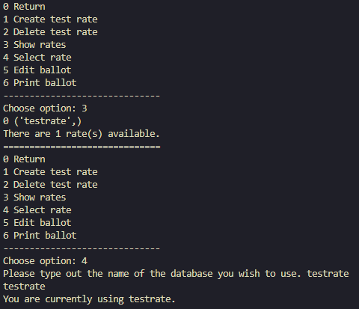
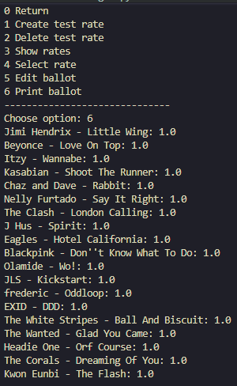

Slide 5
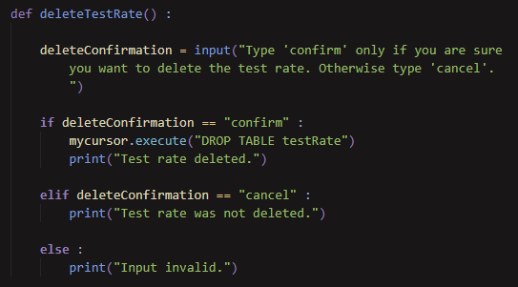
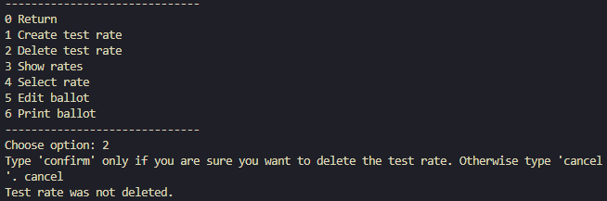


It’s important that for something such as deleting a table, there is strict confirmation needed.
When you cancel deleting the table
Confirming deleting the table
It’s a known bug that deleted tables still show up in the list of rates

Slide 6
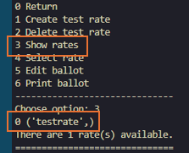
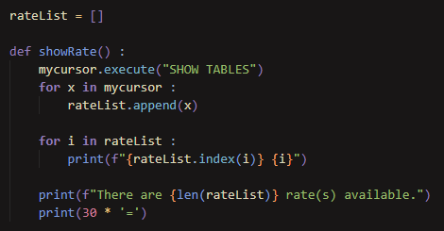
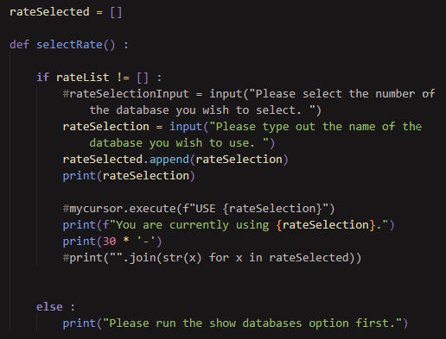
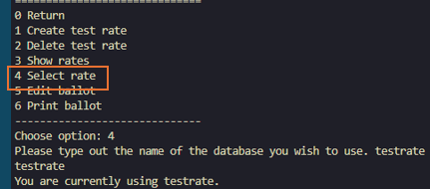
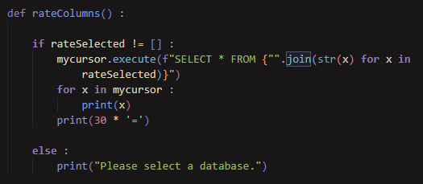
In order to ensure a valid table is selected:

Slide 7
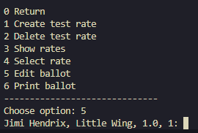
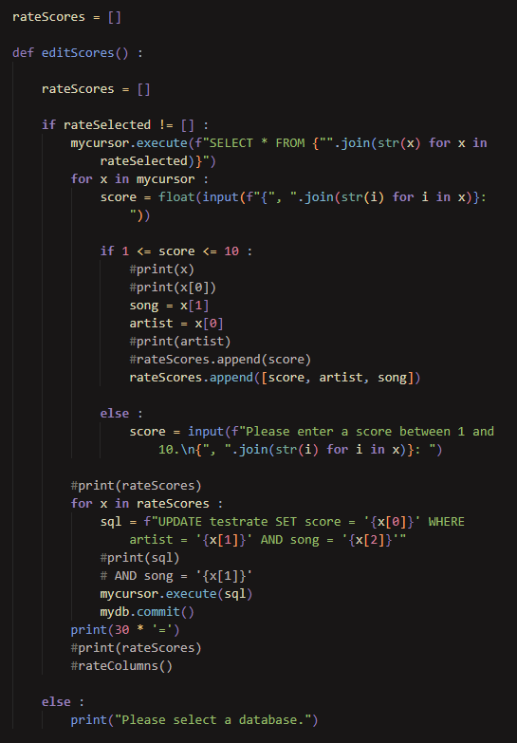
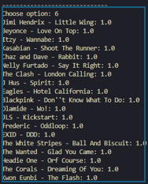

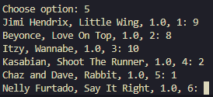

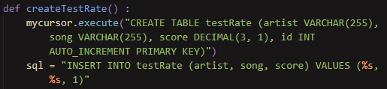
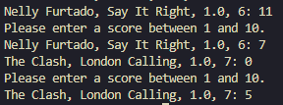
Ballot with default values
Because of how we set up the table, anything with more than 2 decimal places will get rounded
Correctly filled out:
Filled out with values outside the range:

Slide 8
What went well?
I was able to create a functional table that was fully editable, and able to be deleted
There was a clear flow of information in the UI
Several checks were created to ensure the data in the table would be accurate
The python connections to SQL worked exactly as intended
There is a lot of room for expansions to be made in the future with other functionality

Slide 9
What could be improved in the future?
I did not fully realise the extent of planning that is required for an SQL database project
There were several bugs I was not able to correct in the time given, due to the overly ambitious scale of the project
I am very confident that the code can be written in a more efficient way

